Slide 2
1
2
3
N
. . .

Slide 3
Z₂
3
. . .
Z₃
3
. . .
Z₄
3
. . .

Slide 4
Z₂
Sweep

Slide 5
Z₂
Sweep

Slide 6
Z₂
Sweep

Slide 7
(
)
(
)
+
(
)
(
)
+

Slide 10
….
….

Slide 11
3
Z₃
Sweep
3

Slide 12
1
2
3
4
5
6
7
8
9

Slide 13
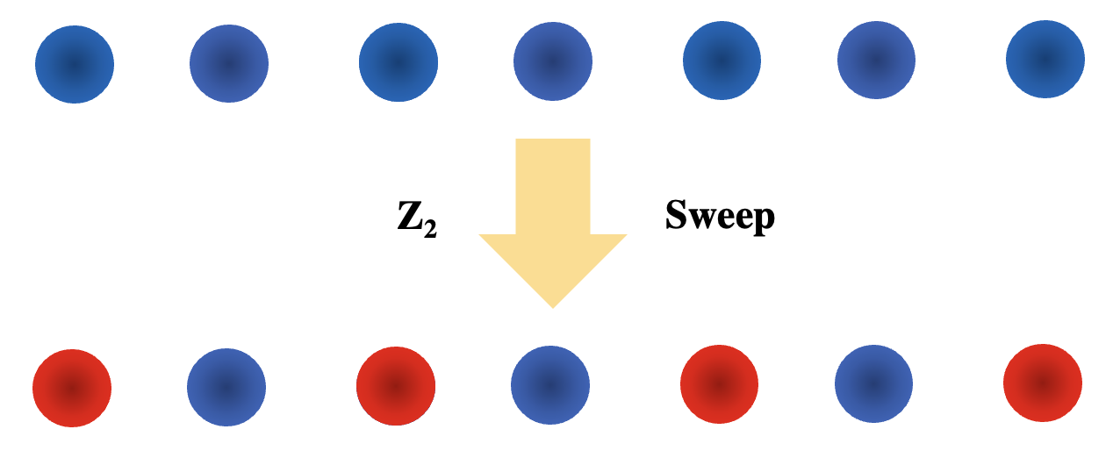
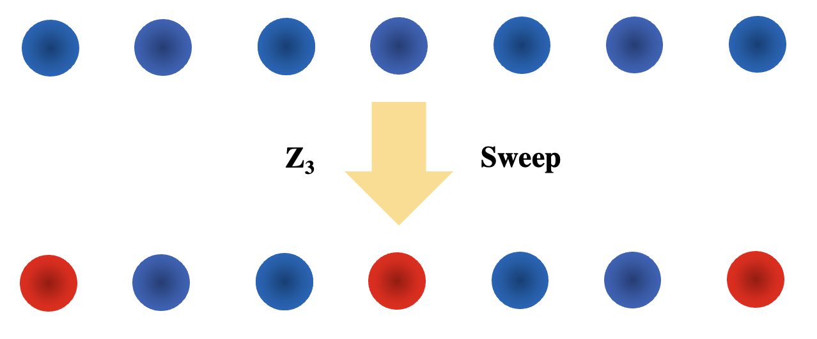

Slide 14
1
2
3
. . .
N
a

Slide 15
Optical
Tweezers
1
2
3
. . .
N
a
a
Driving
Laser

Slide 16
Optical
Tweezers
1
2
3
. . .
N
a
a
Driving
Laser

Slide 17
Optical
Tweezers
1
2
3
. . .
N
a
a
Driving
Laser

Slide 18
1
2
3
. . .
N
a
a

Slide 19
ZXCJK,L.;’\’§
R_{B}
1
2
3
a
a

Slide 20
R_{B}
1
2
3
a
a

Slide 21
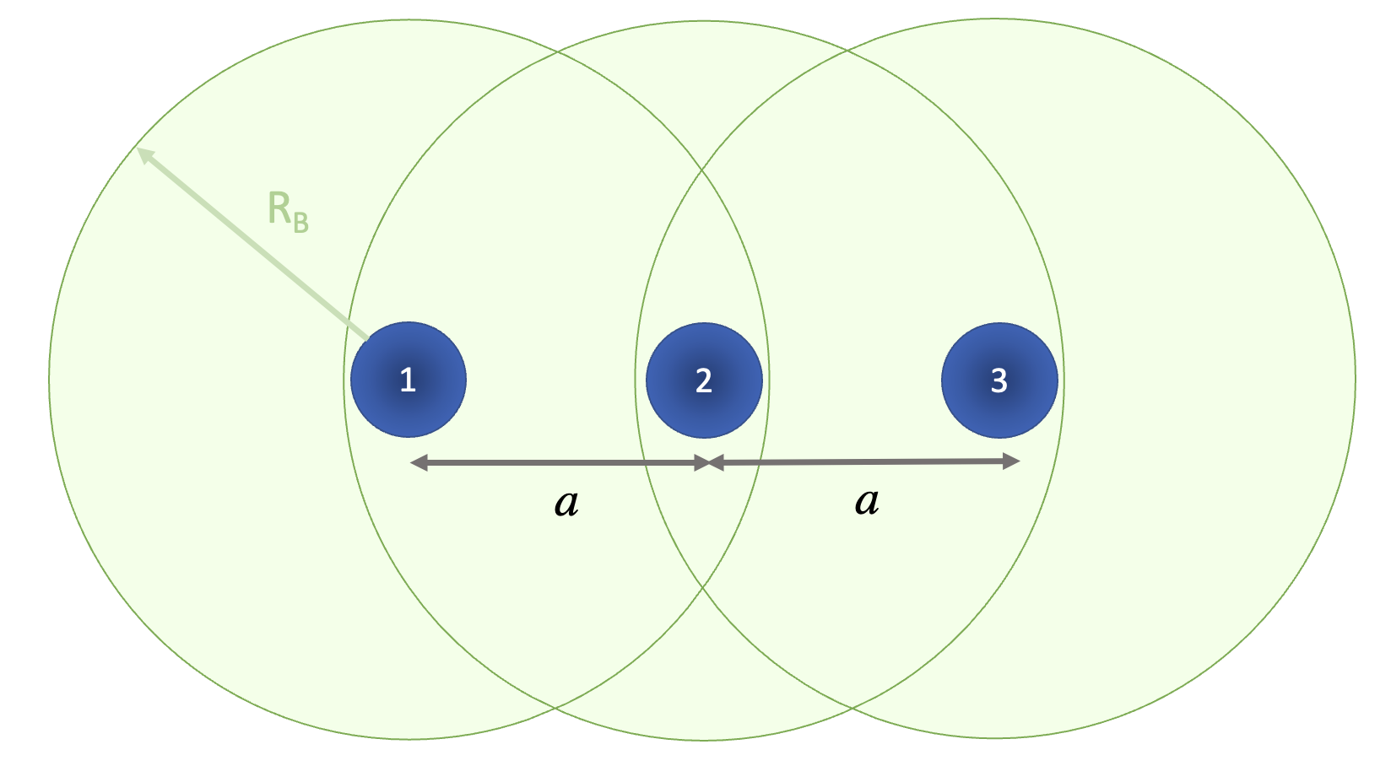
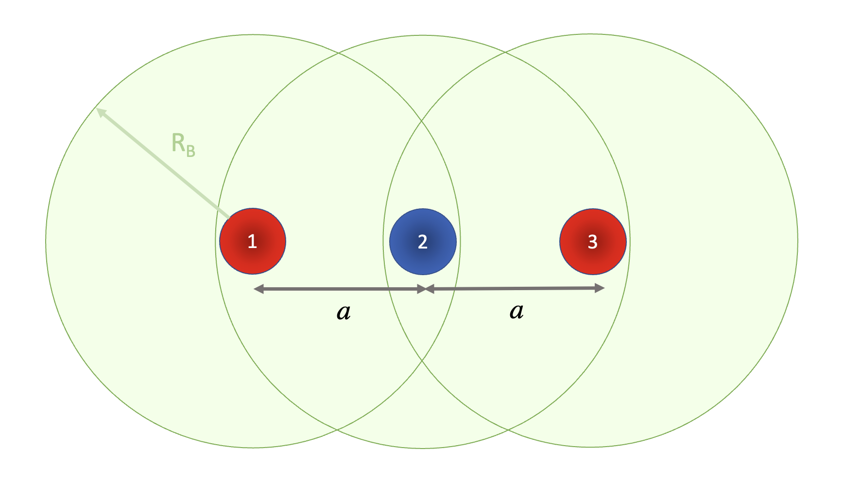
sweep

Slide 22
1
2
3
a
a

